Slide 1
2026 Coaches Meeting

Slide 2
24/25 Board members and Staff
President
Angela Kirkendall
1st Vice President
Jonathan Hale
2nd Vice President
Kat Birkhead
Secretary
Morgan Browning
Registrar
Jennifer Staton
Head Referee
Clark Stout
Referee Assignor/Field Coordinator
Kat Birkhead
Head Rec Commissioner
Kimi Beasley
Competitive/Academy Liaison
Thor Campbell
Adult Commissioner
Frank Rodriguez
Board Member at Large
Vacant
Director of Coaching
Brian Brown
Advisory Member
Ryan Alexander
Emails
President@Claremoresoccerclub.com
Registrar@Claremoresoccerclub.com
Gameassignor@Claremoresoccerclub.com

Slide 3

Important information
Practice may start as of now if the coach has completed all 3 coaching requirements
Field Prep day – August 29th @ 8AM
Schedules should be available September 4th
Games start – September 12th
Lil Kicks start - September 15th
Game Reschedule request
Submit form from the website

Slide 4
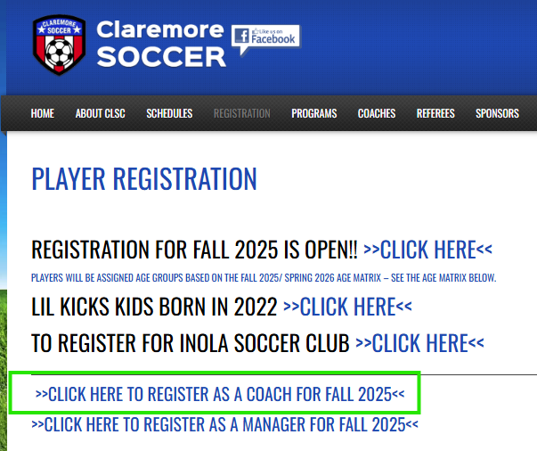

Important information
Register in the coach's program
  https://claremoresoccerclub.com/programs/player-registration/
  Email communications are set to coach's registered in this program

Slide 5
Important information
The Soccer Club is a City park
No pets are allowed except in the parking lot and the walking trail
This includes but is not limited to
Dogs
Cats
Snakes
Horses
No tobacco use is permitted including vapes
No alcohol is allowed

Slide 6
Team information
Head coach can pick a new team name
  Do not change the team's name on your own you must contact Jennifer to change it.
  Check with Jennifer before ordering uniforms if that name is already taken.
    We do not want 2 teams with the same name
All assistant coaches need to be added by Jennifer for them to appear on the game card.

Slide 7
Uniforms
Uniforms are up to each team
Try to keep costs low
Younger teams order shirts as a team, pick a color, and have parents pick up shorts and socks
Many places to order from
ScoreSports.com
Local vendors
Epic Sports
Try to avoid Yellow for the uniform color. Most new referees only have yellow
U12 and down can not have players names on the jersey, First/Last or nickname
U14 and up may have names

Slide 8
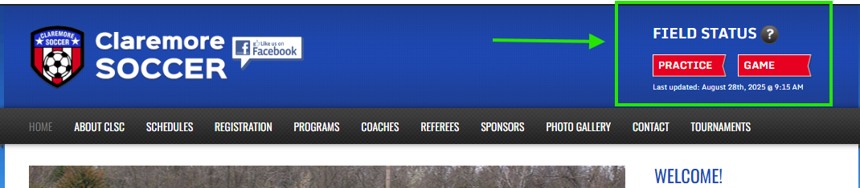
Field Status
The practice and game field status will be updated by 3pm if the status is changing from the day before.
Status can be viewed on the website

Slide 9
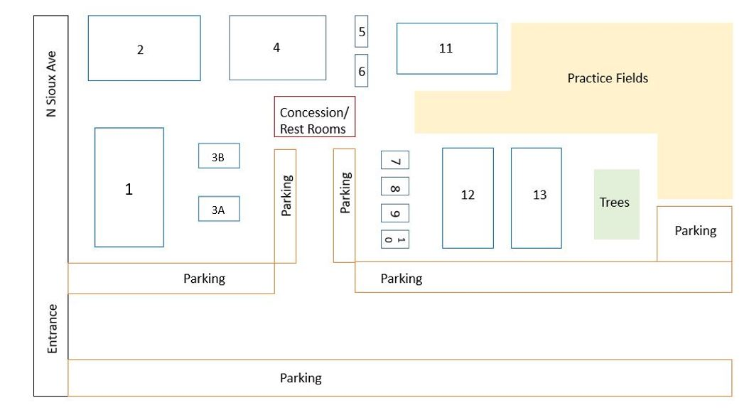
Practice information
No practicing on the game fields
Games fields have nets on the goals and are numbered 1-13
Practice fields do not have nets you may put one up but needs to be taken down after practice
Practice fields are first come first serve
Try to use age-appropriate goals

Slide 10
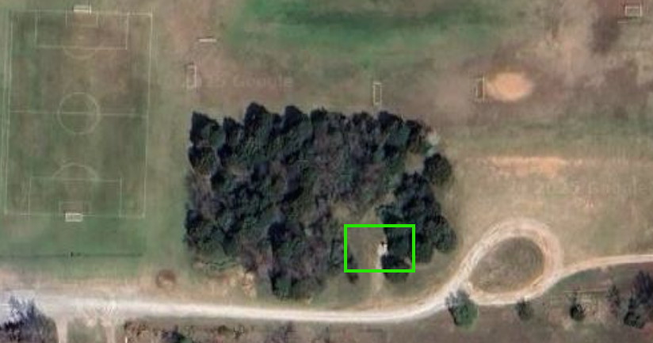
Practice days
Bathrooms at the club house are not guaranteed to be open.
  They will be open if a board member has practice
  There is a porty potty near the practice fields.

Slide 11
Game Fields

Slide 12
Game Fields
Per City contract game fields can only be used for Games and Scrimmages.
This includes the area around the field. Near the sidelines/ directly behind the goals.
Per the city designation a field is still a game field even if it is not painted.(see next page)
The city has stated if we can not get this under control they will remove the use of the complex for practices except for games.
If a team is on a game field and reported to a board member this will count as a scrimmage and additional scrimmage request may be denied. There is also a fine.

Slide 13
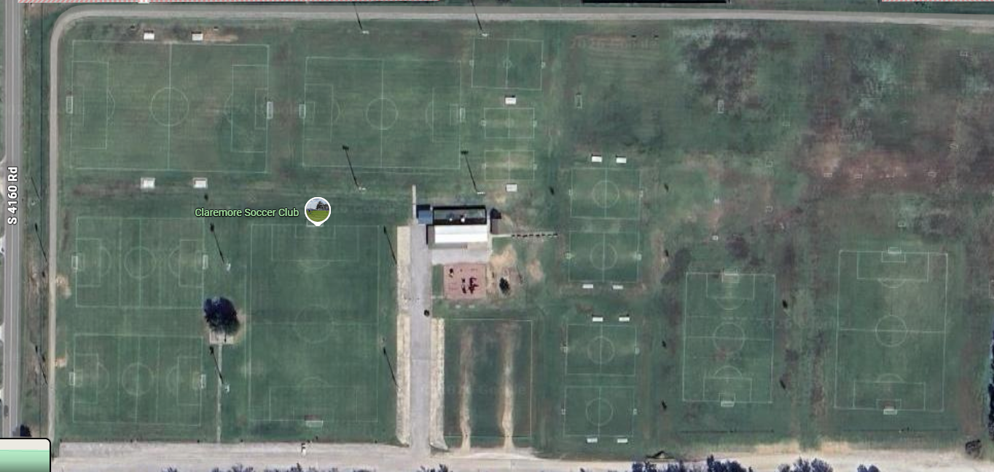
Game Fields
Areas in red are game fields

Slide 14
Game Field unapproved usage
NEW
Coaches Meeting - this is the warning not to use the game fields
If a team is reported with unapproved usage to CLSC of game field usage or seen by a board member.
  1st offence
    $50 fine or 1 game suspension
  2nd offence
    $50 fine and 1 game suspension or 3 game suspension
  3rd offence
    Offending coach will be removed as a coach from the team

Slide 15
Reschedule
And Scrimmage

Slide 16
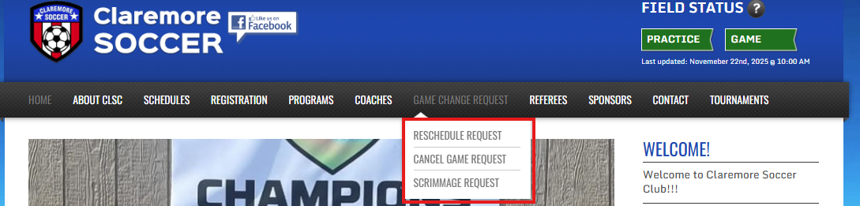
Reschedule Policy
All games should be canceled at least 72 hours prior to game time to avoid referee fees.
Fees:
U8 - $20
U10 - $64
U12 - $94
U14 - $109
U16 - $139
U19 - $164
Contact other coach
Agree on a new date and time
Submit form at Claremoresoccerclub.com
Policy Link

Slide 17
Full day Reschedule Policy
This applies to closed league,.
OSA leagues will need to follow normal reschedule policy
If all games are canceled for the day
CLSC will follow the 8+4 policy
All games on Saturday will move to the following Sunday.
A Game at 9 am on Sept 19th will move to 1 PM Sunday Sept 27th

Slide 18
Scrimmage Request
NEW
Scrimmage request must include another team
Both teams must be in uniform
Request submitted prior to 72 hours in advance of preferred date by form only and will be approved by Referee Assignor and President.
Must have on hand approval email during the scrimmage
Each team is allowed to request 1 scrimmage for free. Second scrimmage will be $20.
Max scrimmages a team can have is 2

Slide 19
Policy's

Slide 20
Zero Tolerance Policy
To help foster sportsmanship and proper conduct Claremore Soccer Club (CSC) has adopted the following Zero Tolerance Policy:
This policy applies to all coaches, players, parents, spectators and other supporters and referees effective immediately.
Abusive and obscene language, violent play/conduct, fighting and other behavior (including, but not limited to sarcasm, taunting, etc.) deemed detrimental to the game between the above-mentioned groups will not be tolerated. It is the responsibility of the coaches to provide referee support and spectator control, and it is the responsibility of all spectators and parents to act appropriately and be positive role models to players. This policy applies before, during and after the game at the soccer field and its immediate surrounding areas.
Policy Link

Slide 21
Zero Tolerance Policy
Coaches shall not interact directly or indirectly with the coaches or players of the opposing team during the game in any manner that may be construed as negative, hostile or sarcastic either by way of demonstrative actions and gestures or by ill-intentioned remarks.
Coaches shall only offer polite and appropriate comments to any call made by the referee(s) at any time.
Coaches shall not address the Referee(s) during the game except to:
Respond to a referee who has initiated a conversation.
Point out emergency or safety issues.
Make substitutions.
Ask the referee, “What is the proper restart (i.e., direction and Indirect Free Kick or Direct Free Kick)?
Ask for the time remaining in the half.
NOTE: Coaches or other team members can not engage in any critical or hostile conversation with the match official once the match has concluded or at half-time.

Slide 22
Zero Tolerance Policy
No parent or spectator shall persistently address the referee or assistant referees at any time. This includes, but is not limited to:
Parents and spectators shall not dispute calls during or after the game.
Parents and spectators shall not make remarks to the referee(s) or advise the referee(s) to watch certain players or attend to rough play.
Parents and spectators shall never yell at the referee(s), including criticism, sarcasm, harassment, intimidation or feedback of any kind before, during or after the game.
The only allowable exceptions to the above are:
Parents and spectators may respond to a referee who has initiated a conversation, until such time as the referee terminates the conversation.
Parents and spectators may point out an emergency or safety issues, such as a player apparently injured on the field or observed fighting.
Additionally, parents and spectators shall not make derogatory comments to players of either team.
We need your help – A lot of the referees for younger games are new and still learning
Coaches you are responsible for parents' actions. A referee can not ask a parent to leave but will ask you to help control the parent or ask them to leave

Slide 23
Safety Plan
Anyone working with the players must have a background check, Heads Up, and SafeSport.
This includes assistant coach or team manager
All practices must be in a public space.
No practices at a private residence – Player and club insurance will not cover an injury at a private residence
Neither the coach nor any adult shall be alone with any of the players without another player or adult being present.
Make sure another person is waiting with you
Policy link

Slide 24
Lightning Policy
Game Day
Practice Days
Board member on duty will watch for lightning.
If lightning is detected within 8 miles air horn will for 5 seconds
Everyone must evacuate the fields to the clubhouse or a vehicle
Do not allow players to go and play on the playground (yes this has happened)
If there is no lightning for 30 minutes games can resume
If you see lightning stop practice
Everyone must evacuate the fields a vehicle
  Do not allow players to go and play on the playground (yes this has happened)
Cancel practice for the remainder of the day
Policy Link

Slide 25
Game day

Slide 26
Game Day
Coaches are responsible to ensure corner flags are on the field before start of the game and put away after the game
U8 and above coach must have a game card printed and available for the referee – Instruction on how to print a game card are found on the website
These can be printed at the clubhouse if you do not have a printer
After the game use the website link at the top of the game card report score
U6 and U8 scores will not be displayed on the website
Ensure team area has been picked up after the game
Substitutions should be ready to enter the game at the Halfway line. Substitutions should not enter the game from the team bench.
U10 and up team must provide player passes to the referee at team check-ins.

Slide 27
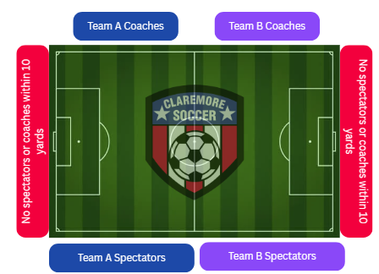
Game Day
Spectators and teams should sit on opposite sides of the field from each other.
No spectator should sit or stand within 10 yards of the end line except on CLSC placed benches. No coaching is allowed from behind the goal line, even on CLSC-provided bleachers.
Spectators should sit behind the designated line or a minimum of 3 feet away from the sideline if a spectator line is not present.
Coaches should stay on their own half of the field or in a designated technical area if marked. Referees can designate a technical area even if one is not painted.

Slide 28

3v3 Jamboree
June 27th
Tournament page

Slide 29
Law changes

Slide 30
U8 changes
NEW
Defender rule
If a defending player steps inside the arc before permitted, the opposing team will be awarded a corner kick.
If an attacking player steps inside the arc before permitted, play will restart with a goal kick for the defending team.

Slide 31
Fall 2026 Age changes
NEW

